Slide 1

Street Use Permit Amendments Overview
External Workshop
SDOT Street Use
Melody Berry, Michelle Allen and Dale Sijera
Notes:
Welcome to the SDOT Seattle Services Portal Amendments overview

Slide 2
Our vision, mission, and core values
Vision: Seattle is a thriving equitable community powered by dependable transportation
Mission: to deliver a transportation system that provides safe and affordable access to places and opportunities
Committed to 6 core values:
Equity
Safety
Mobility
Sustainability
Livability
Excellence

Slide 3
Workshop overview
Accela launch overview
Launch schedule
Extension amendment
Amendment types and descriptions
How to withdraw an application
How to start an amendment process on an issued permit
Revision amendment
How to get help after launch
Events overview and upcoming Q&A sessions
What are amendments
Amendment types by permit type
Date change amendment
Amendment type record ID’s
How amendments interact with the Parent permit

Slide 4
Permit types - what’s coming in November
ROWM Permits
ROW Construction (today’s Construction Use)
ROW Maintenance (new)
Heavy Crane (new)
Minor Utility
Major Permits
Utility Major
Street Improvement
Final Plat

Slide 5
Launch Schedule

Slide 6
External training events
Date, Time | Topic
Sept 14th, 1-2pm | Inspection and Notifications Types Overview
Oct 19th, 3-4pm | Seattle Services Portal (SSP) Overview
Oct 26th, 2-3:30pm | Utility Permit Overview
Oct 28th, 3-4:30pm | Construction Permit Overview
Oct 30th, 11:30am-12:30pm | Street Improvement Permit Overview
Nov 5th, 11am-12pm | Amendment Types Overview
Week of Nov 9th through Dec 8th | General Q&A’s Sessions
One workshop per topic
Each workshop was held virtually using Webex Events and recorded
Previously recorded events can be found on our Accela 2 Updates website

Slide 7
Upcoming Q&A Sessions
Date | Time
Friday, Nov 13th | 10-11am
Tuesday, Nov 17th | 11am-12pm
Friday, Nov 20th | 1-2pm
Wednesday, Dec 2nd | 10-11am
Tuesday, Dec 8th | 11am-12pm
Opportunity to ask Accela and/or business process questions
Each session will be held virtually using WebEx Events
All previously recorded external training workshops can be found on our Accela 2 Updates website

Slide 8

What are amendments – Application initiated
Once an application is submitted, applicants are not able to make changes directly to the application
There is only one Amendment available on the Seattle Services Portal between when the application is submitted to when Street Use starts processing it – ROW Withdrawal
Requests to change application information prior to issuance needs to be sent via email to DOTPermits@seattle.gov
Notes:
Today in Hansen, you have a concept of extensions and modifications. Accela amendments are similar.
Keep in mind that Amendments are used to request changes to issued permits.
If a permit has not yet been issued, changes to the application are handled through a Corrections Cycle, as is discussed in the Review Basics class.
Once a record (permit) is Issued in Accela, a customer can request a change using an Amendment.
In Hansen, permit changes send the issued permit “backwards” to an earlier Hansen Stage.
In Accela, the parent permit stays in the issued status. The new amendment record has its own workflow and status. When the amendment is issued, the parent is updated.
There are different types of amendments, some of which have a very limited scope and one which allows pretty much any change to be requested.
Remember that an amendment is a REQUEST to update an issued permit, just because the applicant submits an amendment doesn’t mean their issued permit will always be updated.
All amendments (except withdrawal) must be approved by SU Staff, just like an application.
If an amendment does not issue, maybe it gets denied or the customer doesn’t pay, the parent permit is not updated.
It is also possible to have an amendment which relates to an application rather than to an issued permit – we will talk about that today as well.

Slide 9

What are amendments – Permit issued
An Amendment on an issued permit is used to request a change to application information (e.g. contacts), scope of work, dates, duration etc.
  Changes to a permit not yet issued are done with a Corrections Cycle
Amendments have different (shorter) process steps than an initial application
Documents are not required for an Amendment, but can be optionally uploaded
When an Amendment is issued, it updates information on its Parent (initial) permit record
Notes:
Today in Hansen, you have a concept of extensions and modifications. Accela amendments are similar.
Keep in mind that Amendments are used to request changes to issued permits.
If a permit has not yet been issued, changes to the application are handled through a Corrections Cycle, as is discussed in the Review Basics class.
Once a record (permit) is Issued in Accela, a customer can request a change using an Amendment.
In Hansen, permit changes send the issued permit “backwards” to an earlier Hansen Stage.
In Accela, the parent permit stays in the issued status. The new amendment record has its own workflow and status. When the amendment is issued, the parent is updated.
There are different types of amendments, some of which have a very limited scope and one which allows pretty much any change to be requested.
Remember that an amendment is a REQUEST to update an issued permit, just because the applicant submits an amendment doesn’t mean their issued permit will always be updated.
All amendments (except withdrawal) must be approved by SU Staff, just like an application.
If an amendment does not issue, maybe it gets denied or the customer doesn’t pay, the parent permit is not updated.
It is also possible to have an amendment which relates to an application rather than to an issued permit – we will talk about that today as well.

Slide 10
Amendment types and descriptions
Amendment Type | Record Status | Description
ROW Withdrawal | Initiated | Withdraw an application
Revision | Issued | Request a change to application information, amend the scope of work, extend a use(s)
ROW Date Change | Issued | Change the start date of a use(s)
ROW Extension | Issued | Extend the end date of a use(s)
Notes:
Here are the Amendments we will discuss today.

Slide 11
Amendment types by permit type
Permit Type | ROW Withdrawal | Revision | ROW Date Change | ROW Extension
ROW Construction | Yes | Yes | Yes | Yes
ROW Maintenance | Yes | X | Yes | Yes
Heavy Crane | Yes | X | Yes | Yes
Minor Utility | Yes | Yes | Yes | Yes
Utility Major | Yes | Yes | Yes | Yes
Street Improvement | Yes | Yes | Yes | Yes
SDOT Final Plat | Yes | X | X | X
Notes:
Here are the Amendments we will discuss today.

Slide 12
Amendment record ID’s
Amendment Type | Record ID
ROW Withdrawal | [Parent Record ID] – AW001
Revision | [Parent Record ID] – A001
ROW Date Change | [Parent Record ID] – ADC001
ROW Extension | [Parent Record ID] – EXT001
  If multiple amendments are issued, the number string will be additive
  (e.g. A002, A003; EXT001, EXT002 etc.)
Notes:
Here are the Amendments we will discuss today.

Slide 13
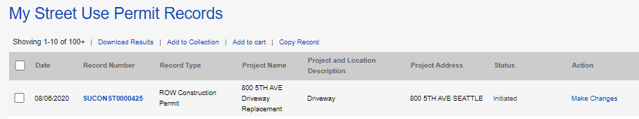
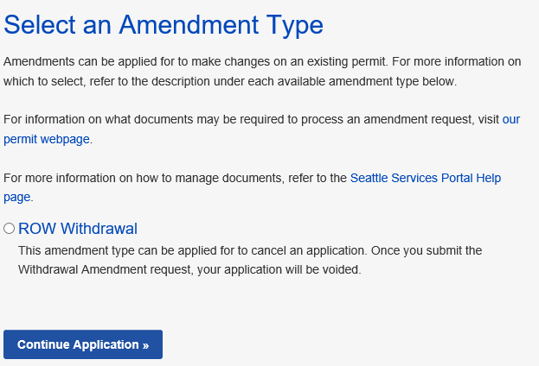
How to withdraw an application
1
  If the permit is in the Initiated stage, under Action, Click on the Make Changes link
    Tip: This is only available between application submitted and when SU staff claims the application for processing.
  Select ROW Withdrawal
  Click the Continue Application button
2
3

Slide 14
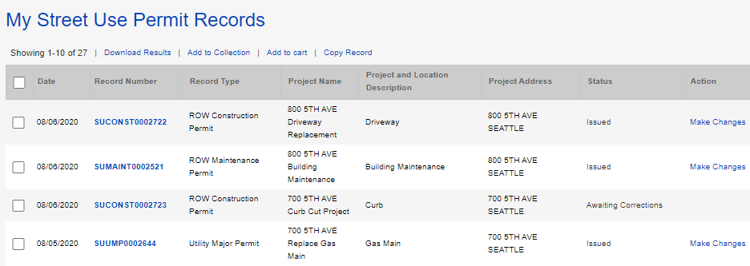
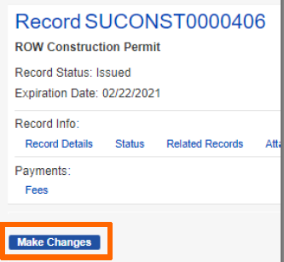
How to start an amendment process on an issued permit
  If the permit is in the Issued stage, under Action, Click on the Make Changes link
  From the individual record, click on the Make Changes button
1
2
Notes:
Once an application has been reviewed and approved, the customer receives an email letting them know the permit is ready to issue and waiting for payment. Fees can be paid online. Online payment only allows full payment and only credit cards.
Remember, for billed customers, the permit is issued without payment.
If it’s a free permit, the customer receives an email stating that the permit has been issued and is ready for printing.
Now let’s look at the Fees tab on the record.

Slide 15
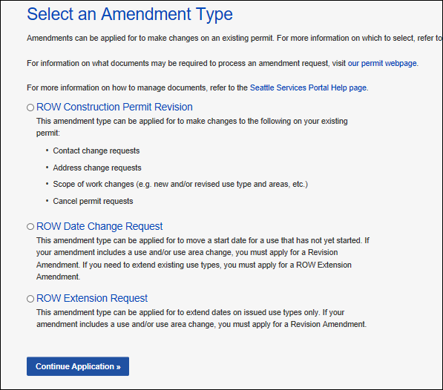
How to start an amendment process on an issued permit
  Select the appropriate amendment type
  Click the Continue Application button to start the amendment application process
3
4

Slide 16
Revision amendment overview
  The Revision Amendment can be used to request one or more of the following:
      Contact change(s)
      Address change
      Related information change(s) (e.g. 24-hour contact, restoration party etc.)
      Scope of work change(s) (e.g. new and/or revised use types and areas)
      Extend the end date of a use(s)
Notes:
We will look at what the applicant sees when they initiate a Revision Amendment in the Seattle Services portal.

Slide 17
Revision amendment application steps
Select Revision Amendment Type
Review Parent Application Information
Enter Amendment Description
Extend and/or Add Use(s)
Upload Docs
Review Application
Information
Submit & Thank You

Slide 18
Revision amendment application steps
1
  Select the [Permit Type] Revision amendment type
  Click the Continue Application button
2

Slide 19
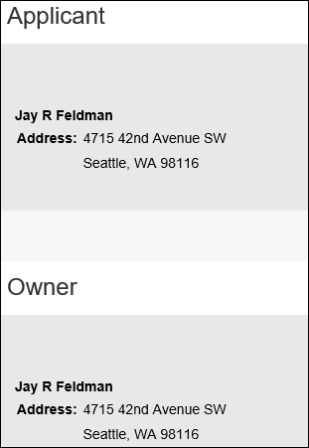
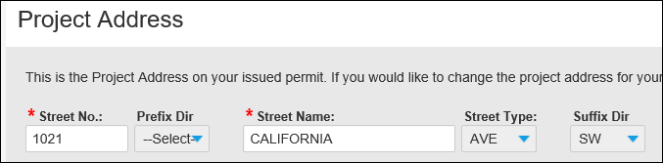
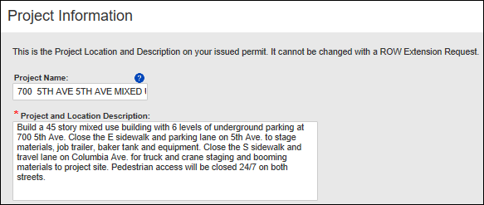
Revision amendment application steps
  Review read-only information copied from the Parent permit
3
Notes:
Once an amendment type has been selected, the Project Address pages displays.
The Project Address, Contacts and Project Information pages all display information copied from the parent (issued) permit, with no updates allowed. This helps the applicant confirm they chose the correct record to amend.
[Point out text on the address and project information pages that says they can’t be changed in the amendment]
After reviewing information on the Address, Contact and Project Information Pages, the applicant continues to the next page where they begin entering updated information on the amendment
Note: the selection of the amendment type and the read-only display of the Project Address, Contacts and Project Information pages are the same for all SU R2 amendments (except the withdrawal)

Slide 20
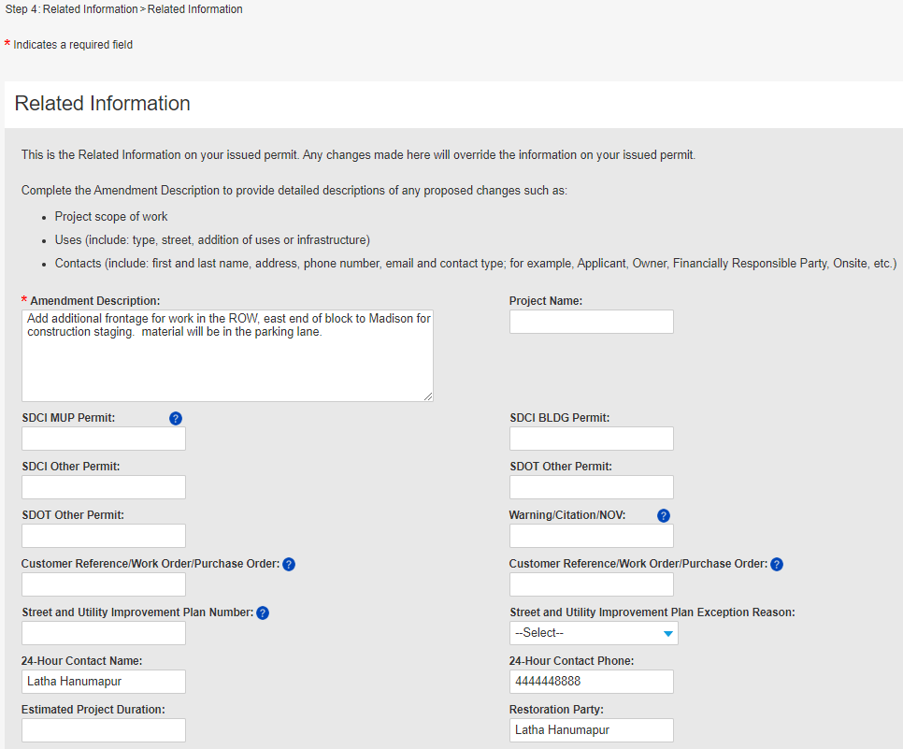
Revision amendment application steps
  Enter the Amendment Description
  Tip: Since you can’t update read-only fields, add all the information you want to change in the Amendment Description.
4

Slide 21
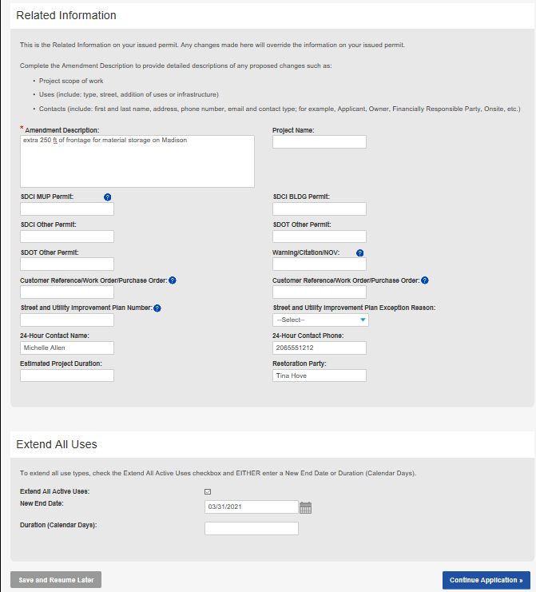
Revision amendment application steps
  If you want to extend a use(s):
    On the Related Information page, click on the Extend All Uses box
    Either enter a new start date using the calendar icon in the New End Date field; or
    Enter the desired duration in the Duration field
    Click the Continue Application button
a
b
c
d

Slide 22
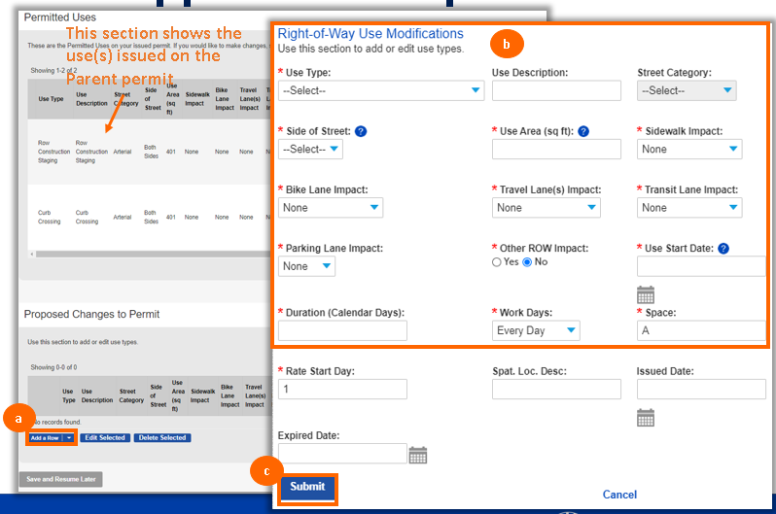
Revision amendment application steps
  If you want to add a use(s):
    Click on the Add a Row button
    Enter all required information in the Right-of-Way Use Modifications pop-up window
    Click the Submit button
    Repeat steps as needed
    Once all uses have been added, click the Continue Application button

Slide 23
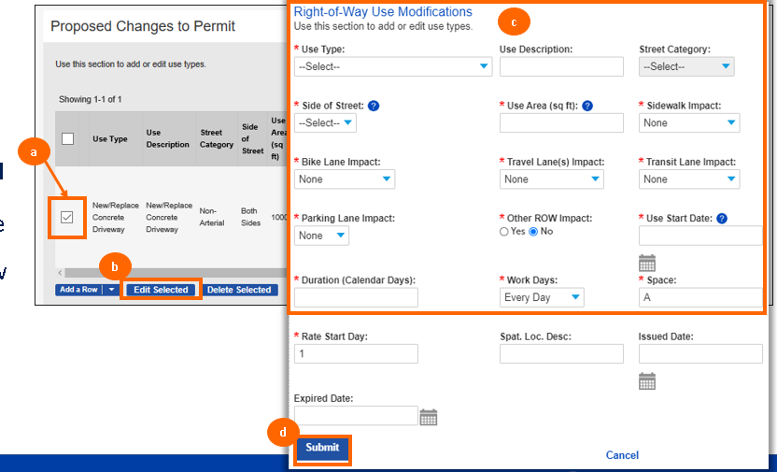
Revision amendment application steps
  If you want to edit a use(s) that was added or extended:
    Select the use you want to edit
    Click the Edit Selected button
    Edit information in the Right-of-Way Use Modifications window
    Click the Submit button
    Repeat steps as needed
    Once editing is complete, click the Continue Application button
Notes:
At the bottom of the Related Information page is the option to Extend All Uses
This option allows the applicant to extend all of the uses on the parent permit, even those that are expired
We will look at the Extend All Uses option soon, but for right now we will look at the amendment process if Extend All Uses is not used
If the amendment does not require any extension of existing Uses then the Extend All Uses section can be left blank
The next page in the Amendment process is the Use Information page
As we saw for the Extension amendment, the Right of Way Use Details section contains all of the uses copied from the parent permit, even those that are expired
And as with the Extension Amendment, the Uses in the Right of Way Use Details section is for reference only, so the applicant can see the current uses. But no updates can be made in that section.
However, unlike the Extension Amendment there is a “Proposed Changes to Permit” section on the Use Information page.
This applicant uses this section to provide information about any new uses they want to add to their permit. Or to modify an existing use going forward.
If Extend All Uses is not used, the Proposed Changes to Permit section does not have any entries.
If no use changes at all are needed for this amendment then the Proposed Changes to Permit section can be left blank
If a new use is needed on the permit, the applicant uses the Add a Row button in the Proposed Changes to Permit section
Then the Right of Way use modifications popup displays for the applicant to enter information about the requested new use.
When the new Use Details are saved, the new Use information displays in the Proposed Changes to Permit section
The applicant can request more than one new use, or they can leave the Proposed Changes to Permit section blank if they don’t need any use changes

Slide 24
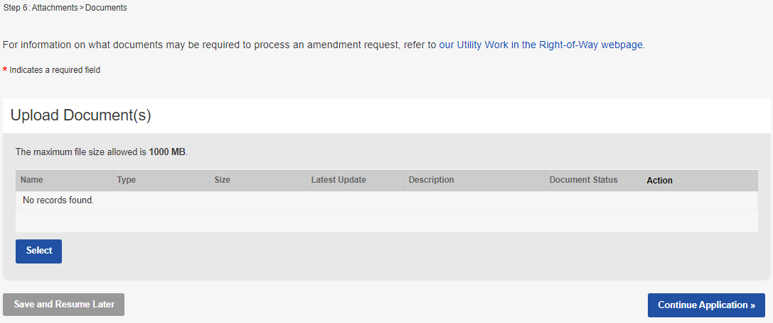
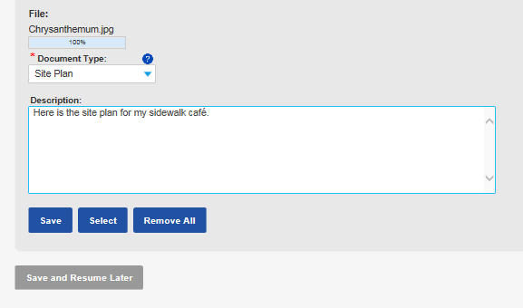
Revision amendment application steps
  To upload a document:
    Click on the Select button
    Choose the desired document from your computer
    From the Document Type drop-down menu, select the type of document you are uploading
    Tip: For us to perform efficient plan review, only upload PDF documents.
    Add a description (optional)
    Click the Save button
    To upload another document, click the Select button
    To move to the next step, click on the Continue Application button
a
c
g
d
e
f
Notes:
After the use information has (optionally) been entered, the Upload Documents page displays. The applicant is not required to upload any documents in order to submit an amendment.
But depending on the nature of the change requested, the applicant may already know that additional documents will be required. OR, the SU Reviewer may determine that documents are needed and request them during review.
The last page in the SSP amendment process is the Review page, just like the application, this allows the applicant to review the information they’ve entered and also to go back and make additional or different changes to sections which are editable.

Slide 25
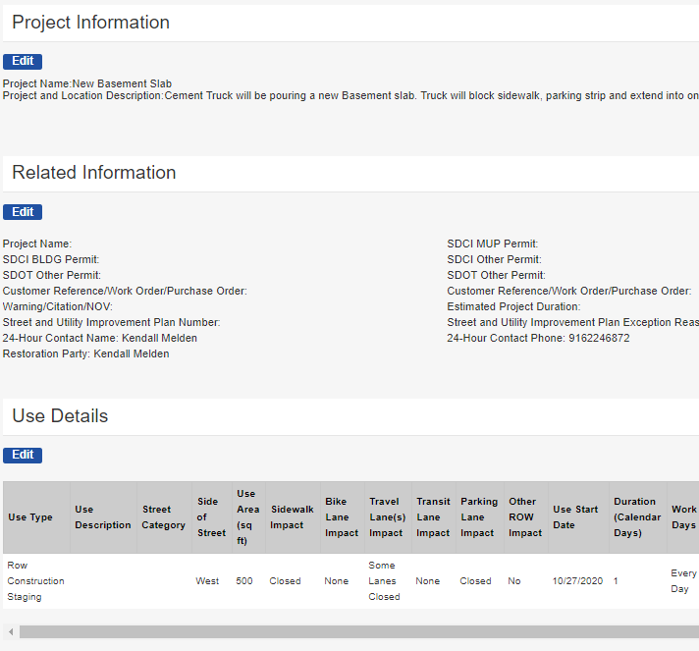
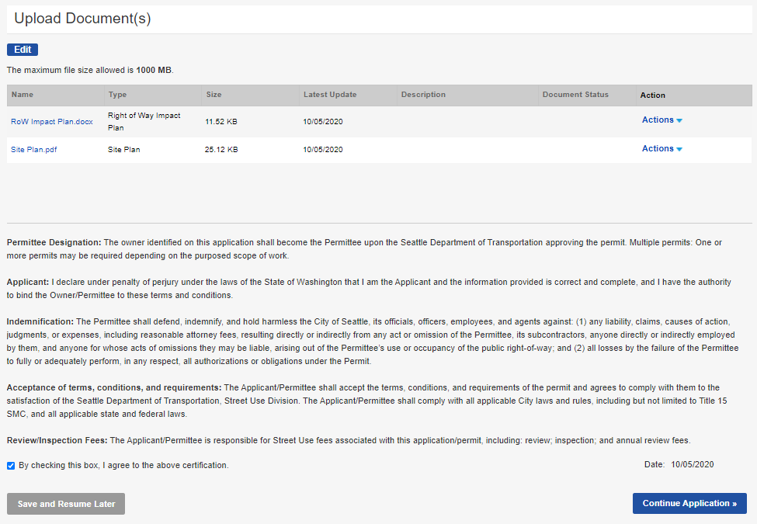
Revision amendment application steps
  Go through all application pages to ensure information is accurate (use the Edit button to make changes)
  Once the application is ready to submit:
    Check the terms of agreement box
    Click the Continue Application button
a
b
Notes:
After the use information has (optionally) been entered, the Upload Documents page displays. The applicant is not required to upload any documents in order to submit an amendment.
But depending on the nature of the change requested, the applicant may already know that additional documents will be required. OR, the SU Reviewer may determine that documents are needed and request them during review.
The last page in the SSP amendment process is the Review page, just like the application, this allows the applicant to review the information they’ve entered and also to go back and make additional or different changes to sections which are editable.

Slide 26
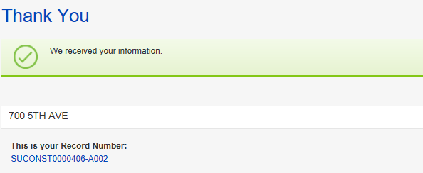
Revision amendment application steps
  Once the application is submitted, you will receive a Thank You confirmation with your Record Number noted
  You can open the permit by clicking on the blue hyperlink permit number
11
12
Notes:
After the use information has (optionally) been entered, the Upload Documents page displays. The applicant is not required to upload any documents in order to submit an amendment.
But depending on the nature of the change requested, the applicant may already know that additional documents will be required. OR, the SU Reviewer may determine that documents are needed and request them during review.
The last page in the SSP amendment process is the Review page, just like the application, this allows the applicant to review the information they’ve entered and also to go back and make additional or different changes to sections which are editable.

Slide 27
Date Change amendment
  A Date Change Amendment is used to request a change to the start date of a use on an issued permit before the start of the use
  Uses cannot be added or extended
  No other changes can be requested
Notes:
We will look at what the applicant sees when they initiate an Extension Amendment in the Seattle Services portal

Slide 28
Date Change amendment
  Only the start date of a use(s) can change
  The previously issued duration cannot change
  If you need to change the duration, you will need to apply for a Revision or ROW Extension amendment
Original Use Period
New Use Period With Same Duration
Notes:
We will look at what the applicant sees when they initiate an Extension Amendment in the Seattle Services portal

Slide 29
Date Change amendment application steps
Select Date Change Amendment Type
Review Parent Application Information
Move Use Start Date
Upload Docs
Review Application
Information
Submit & Thank You

Slide 30
Date Change amendment application steps
  Select the ROW Date Change amendment type
  Click the Continue Application button
1
2
Notes:
To make a Date Change Request, go to the Seattle Services Portal amendment type page, then select the amendment type.

Slide 31
Date Change amendment application steps
  Review read-only information copied from the Parent permit
3
Notes:
Once an amendment type has been selected, the Project Address pages displays.
The Project Address, Contacts and Project Information pages all display information copied from the parent (issued) permit, with no updates allowed. This helps the applicant confirm they chose the correct record to amend.
[Point out text on the address and project information pages that says they can’t be changed in the amendment]
After reviewing information on the Address, Contact and Project Information Pages, the applicant continues to the next page where they begin entering updated information on the amendment
Note: the selection of the amendment type and the read-only display of the Project Address, Contacts and Project Information pages are the same for all SU R2 amendments (except the withdrawal)

Slide 32
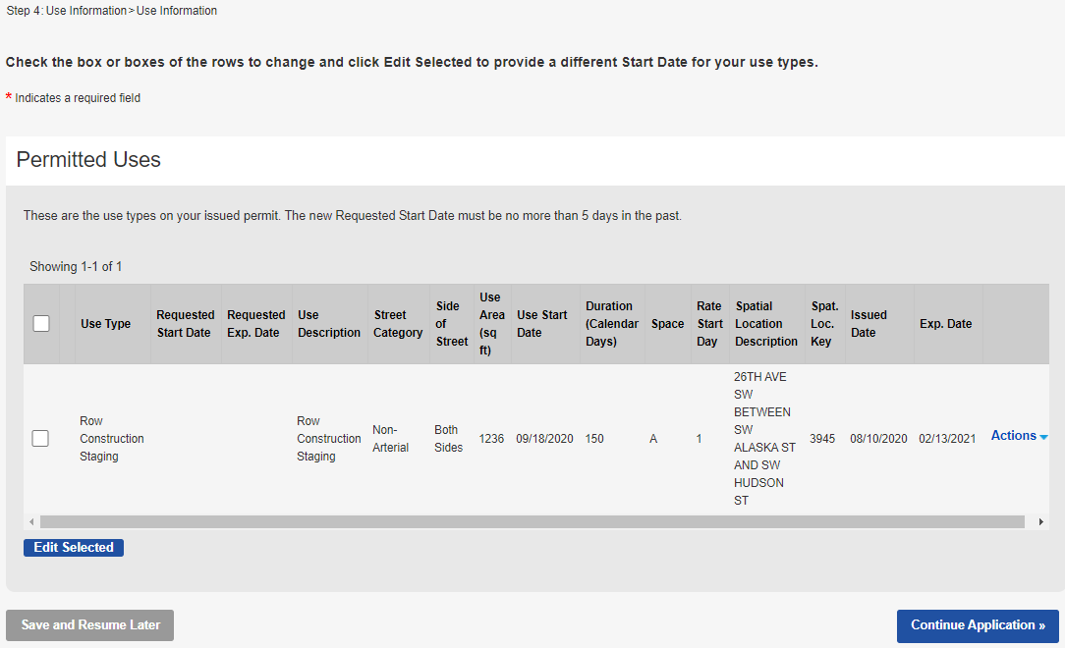
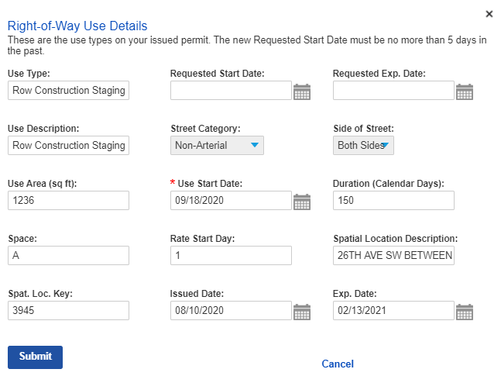
Date Change amendment application steps
    To change the use start date:
    Select the use you want to change
    Click the Edit Selected button
    Enter the new use start date in the Requested Start Date field
    Click the Submit button
    Repeat steps as needed
    Once all uses have been updated, click the Continue Application button
Initial use start date
c
a
b
d

Slide 33
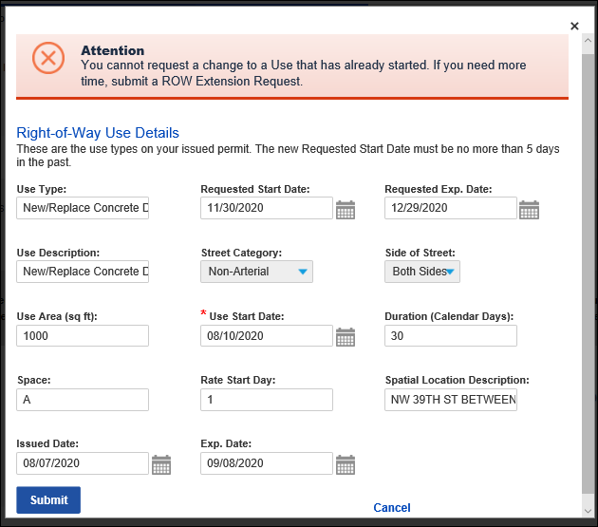
Date Change amendment application rules
1
If the initial issued Use Start Date is in the past, an error message will populate in the banner
    To change a Use Start Date that is in the past, you will have to apply for a Revision or ROW Extension amendment

Slide 34
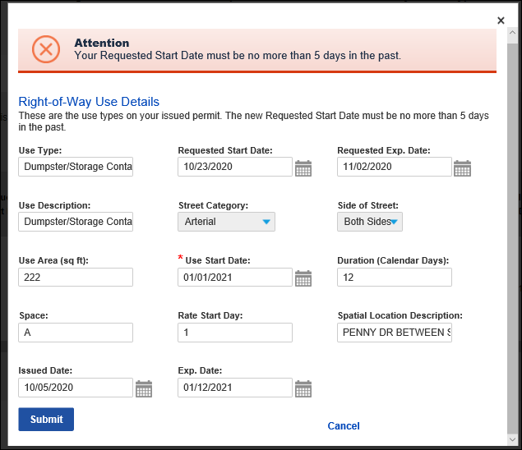
Date Change amendment application rules
2
If the initial issued Use Start Date is in the future and you request a new start date more than 5 days in the past, you will receive an error in the banner
The Requested Start Date will have to be changed to be less than 5 days in the past or apply for a Revision or ROW Extension amendment
Tip: These are the same rules on a Revision amendment. If you need to backdate, use the Revision amendment and note in the Amendment Description what dates are needed.
3

Slide 35
Date Change amendment application steps
  If you want to edit a use(s):
    Select the use you want to edit
    Click the Edit Selected button
    Edit the Requested Start Date in the Right-of-Way Use Modifications pop-up window
    Click the Submit button
    Repeat steps as needed
    Once editing is complete, click on the Continue Application button
c
d

Slide 36
Date Change amendment application steps
  To upload a document:
    Click on the Select button
    Choose the desired document from your computer
    From the Document Type drop-down menu, select the type of document you are uploading
    Tip: For us to perform efficient plan review, only upload PDF documents.
    Add a description (optional)
    Click the Save button
    To upload another document, click the Select button
    To move to the next step, click on the Continue Application button
a
c
g
d
e
f
Notes:
After the use information has (optionally) been entered, the Upload Documents page displays. The applicant is not required to upload any documents in order to submit an amendment.
But depending on the nature of the change requested, the applicant may already know that additional documents will be required. OR, the SU Reviewer may determine that documents are needed and request them during review.
The last page in the SSP amendment process is the Review page, just like the application, this allows the applicant to review the information they’ve entered and also to go back and make additional or different changes to sections which are editable.

Slide 37
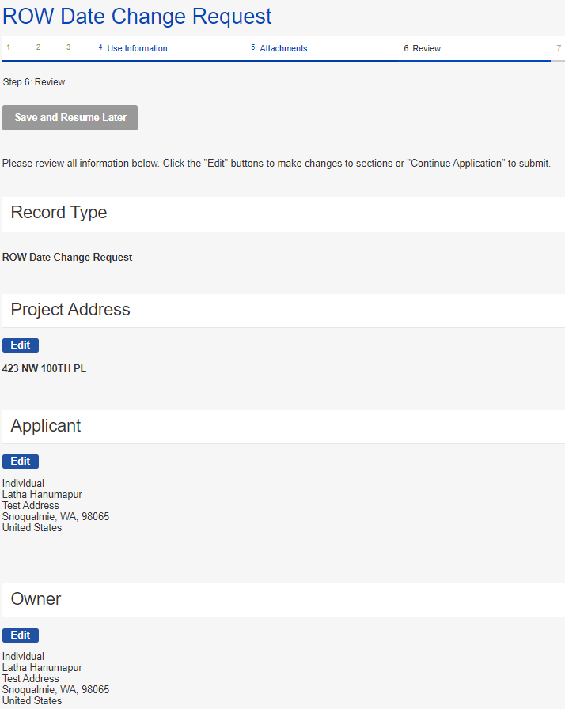
Date Change amendment application steps
  Go through all application pages to ensure information is accurate (use the Edit button to make changes)
  Once the application is ready to submit:
    Check the terms of agreement box
    Click the Continue Application button
a
b
37
Notes:
After the use information has (optionally) been entered, the Upload Documents page displays. The applicant is not required to upload any documents in order to submit an amendment.
But depending on the nature of the change requested, the applicant may already know that additional documents will be required. OR, the SU Reviewer may determine that documents are needed and request them during review.
The last page in the SSP amendment process is the Review page, just like the application, this allows the applicant to review the information they’ve entered and also to go back and make additional or different changes to sections which are editable.

Slide 38
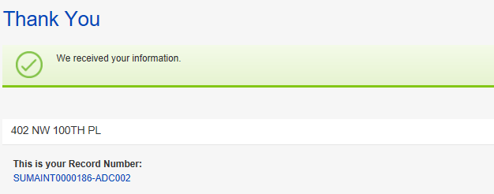
Date Change amendment application steps
  Once the application is submitted, you will receive a Thank You confirmation with your Record Number noted
  You can open the permit by clicking on the blue hyperlink permit number
9
10
38

Slide 39
Extension amendment
  An Extension Amendment is used to request the extension of an existing use(s) on an issued permit
  Uses cannot be added
  No other change can be requested
  Tip: If you need to make a change to application information or add/change a use, you can do all of that under the Revision amendment.
Notes:
Extension Amendment

Slide 40
Extension amendment application steps
Select Extension Amendment Type
Review Parent Application Information
Extend Uses
Upload Docs
Review Application
Information
Submit & Thank You

Slide 41
Extension amendment application steps
  Select the ROW Extension amendment type
  Click the Continue Application button
1
2
Notes:
To make a Date Change Request, go to the Seattle Services Portal amendment type page, then select the amendment type.

Slide 42
Extension amendment application steps
  Review read-only information copied from the Parent permit
3
Notes:
Once an amendment type has been selected, the Project Address pages displays.
The Project Address, Contacts and Project Information pages all display information copied from the parent (issued) permit, with no updates allowed. This helps the applicant confirm they chose the correct record to amend.
[Point out text on the address and project information pages that says they can’t be changed in the amendment]
After reviewing information on the Address, Contact and Project Information Pages, the applicant continues to the next page where they begin entering updated information on the amendment
Note: the selection of the amendment type and the read-only display of the Project Address, Contacts and Project Information pages are the same for all SU R2 amendments (except the withdrawal)

Slide 43
Revision amendment application steps
  If you want to extend all uses:
    On the Related Information page, click on the Extend All Uses box
    Either enter a new start date using the calendar icon in the New End Date field; or
    Enter the desired duration in the Duration field
    Click the Continue Application button
a
b
c
d

Slide 44
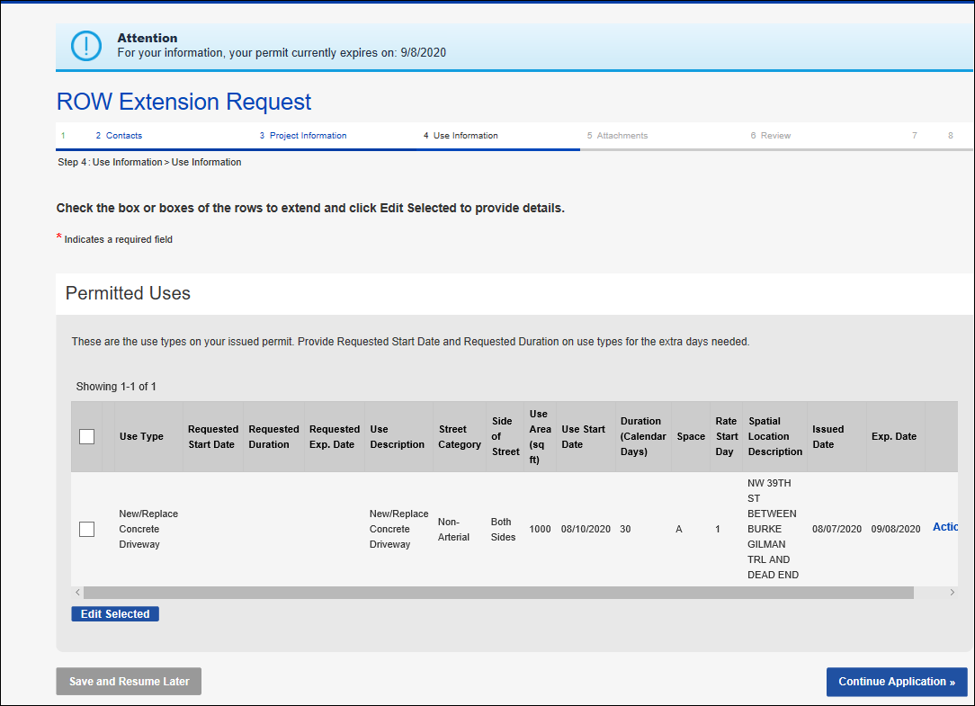
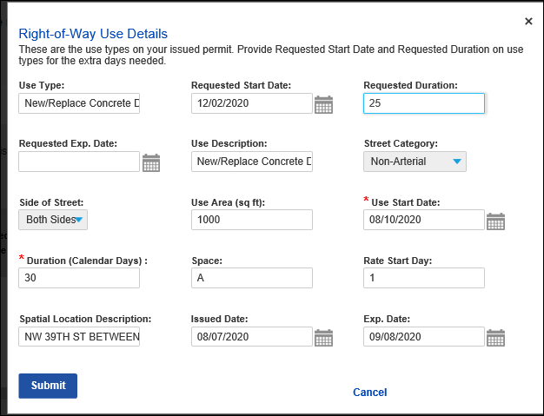
Extension amendment application steps
This banner alerts you of the expiration date from the Parent permit
  To extend one use at a time:
    On the Use Information page, click on box next to the use you want to extend
    Click the Edit Selected button
    In the Right-of-Way Use Details pop-up window, complete the Requested Start Date and Requested Duration fields
    Click the Submit button
    Repeat steps as needed to extend additional uses
    Once all uses have been extended, click the Continue Application button
  TIP: You must extend at least 1 use row before clicking Continue Application or you will get an error.
c
d
a
b
f

Slide 45
Extension amendment application steps
  To edit a use(s):
    On the Use Information page, click on box next to the use you want to edit
    Click the Edit Selected button
    In the Right-of-Way Use Details pop-up window, update the Requested Start Date and Requested Duration fields as needed
    Click the Submit button
    Repeat steps as needed
    Once editing is complete, click the Continue Application button
c
d

Slide 46
Extension amendment application steps
  To upload a document:
    Click on the Select button
    Choose the desired document from your computer
    From the Document Type drop-down menu, select the type of document you are uploading
    Tip: For us to perform efficient plan review, only upload PDF documents.
    Add a description (optional)
    Click the Save button
    To upload another document, click the Select button
    To move to the next step, click on the Continue Application button
a
c
g
d
e
f
Notes:
After the use information has (optionally) been entered, the Upload Documents page displays. The applicant is not required to upload any documents in order to submit an amendment.
But depending on the nature of the change requested, the applicant may already know that additional documents will be required. OR, the SU Reviewer may determine that documents are needed and request them during review.
The last page in the SSP amendment process is the Review page, just like the application, this allows the applicant to review the information they’ve entered and also to go back and make additional or different changes to sections which are editable.

Slide 47
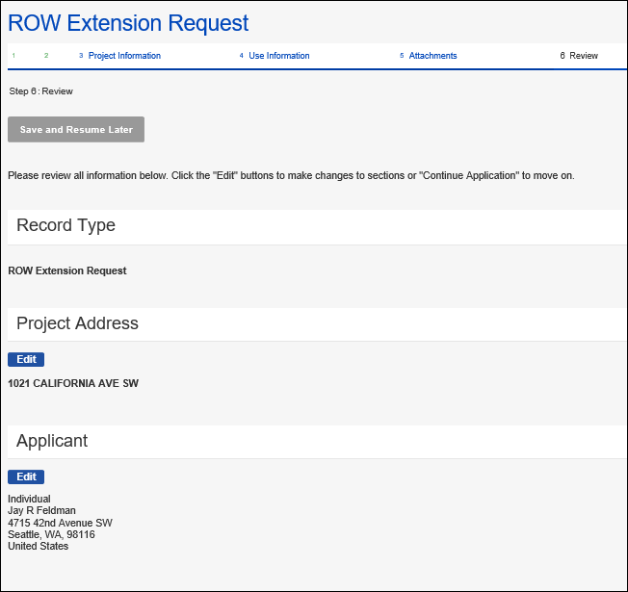
Extension amendment application steps
  Go through all application pages to ensure information is accurate (use the Edit button to make changes)
  Once the application is ready to submit:
    Check the terms of agreement box
    Click the Continue Application button
a
b
47
Notes:
After the use information has (optionally) been entered, the Upload Documents page displays. The applicant is not required to upload any documents in order to submit an amendment.
But depending on the nature of the change requested, the applicant may already know that additional documents will be required. OR, the SU Reviewer may determine that documents are needed and request them during review.
The last page in the SSP amendment process is the Review page, just like the application, this allows the applicant to review the information they’ve entered and also to go back and make additional or different changes to sections which are editable.

Slide 48
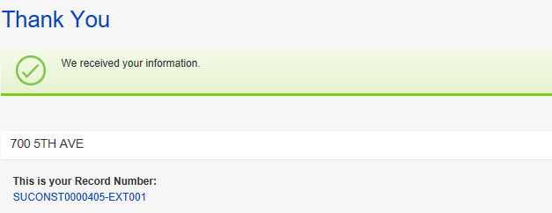
Extension amendment application steps
  Once the application is submitted, you will receive a Thank You confirmation with your Record Number noted
  You can open the permit by clicking on the blue hyperlink permit number
10
11
48

Slide 49
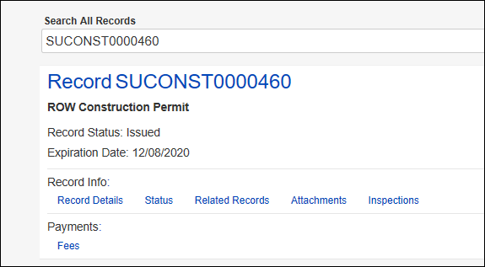
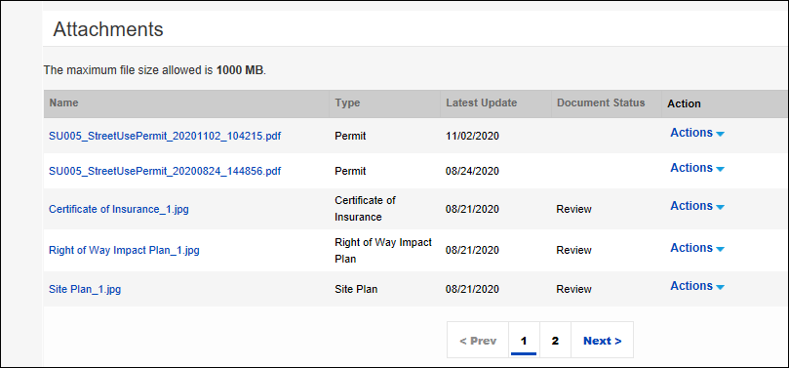
How amendments interact with the Parent permit
Once a Revision, Date Change or Extension amendment is issued:
  The amendment record will close
  The amendment information will show on the Parent (initial) permit
To find the current permit report:
  Open the Parent (initial) permit from the Portal
  Click on the Attachments tab
  Click 2x on the Latest Update header to sort the most recent permit document to the top of the list
  Click the blue hyperlink to open the document
a
b
c
d

Slide 50
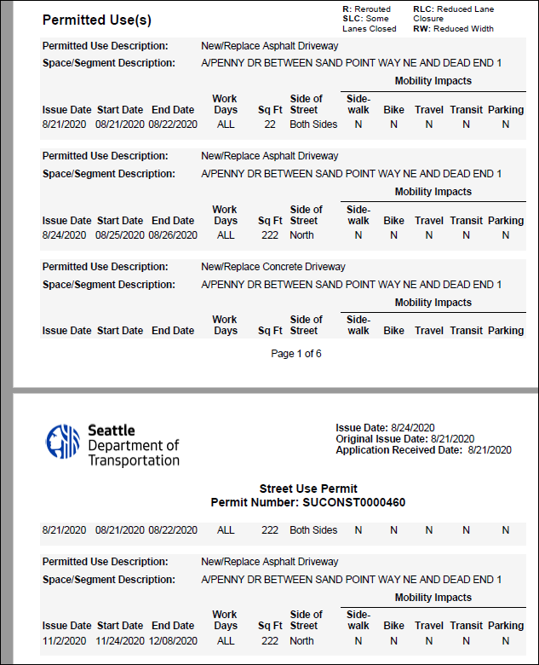
How amendments interact with the Parent permit
Initial Use
The Issue Date will indicate the date the use was issued
Tip: For Date Change amendments, instead of an additional use line being added, the Start Date will be updated in the initial use line.
Amended Use

Slide 51
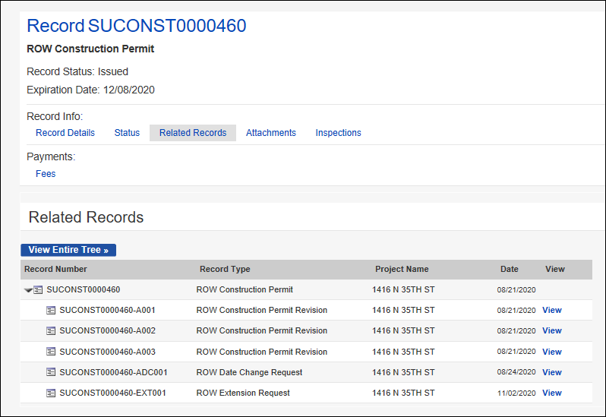
How amendments interact with the Parent permit
Amendments will show as a related record to the Parent permit
To find all related records:
  Open the Parent (initial) permit from the Portal
  Click on the Related Records tab
  Click on the View Entire Tree button
  All associated amendments will show in the list
a
b
c
d

Slide 52
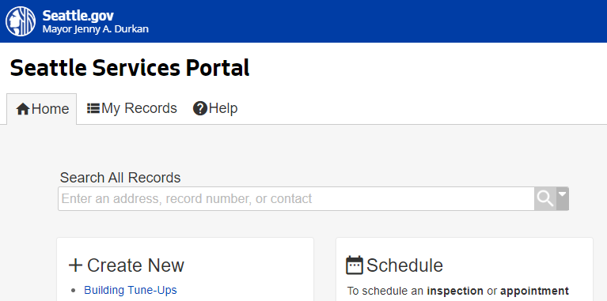
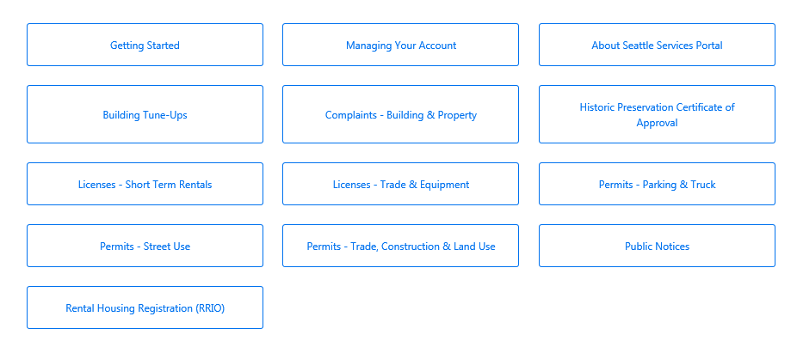
How to Find Help After Launch
1
How to find help on the Portal
From the Seattle Services Portal home page, click on Help
Click on any of these pages:
    Getting Started
    Managing Your Account
    Permits - Street Use
2

Slide 53
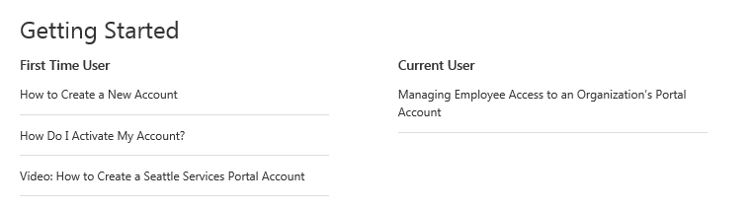
How to Find Help After Launch
Under Getting Started, the following topics have Help articles and a bonus video
  How to create a new account
  How to activate an account
  How to manage employee access for an Organization’s Portal account
Notes:
When a user needs help, they can access the Help Center articles by clicking on Help.
The banner is available throughout the portal, and Help can be accessed at any time simply by clicking on the Help button.

Slide 54

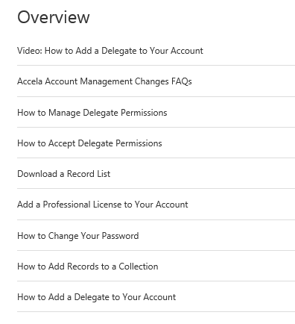
How to Find Help After Launch
Under Managing Your Account, the following topics have Help articles and a bonus video
  Account management FAQ’s
  How to manage delegate permissions
  How to accept delegate permissions
  Download a record list
  Add a professional license to your account
  How to change your password
  How to add records to a collection
Notes:
When a user needs help, they can access the Help Center articles by clicking on Help.
The banner is available throughout the portal, and Help can be accessed at any time simply by clicking on the Help button.

Slide 55
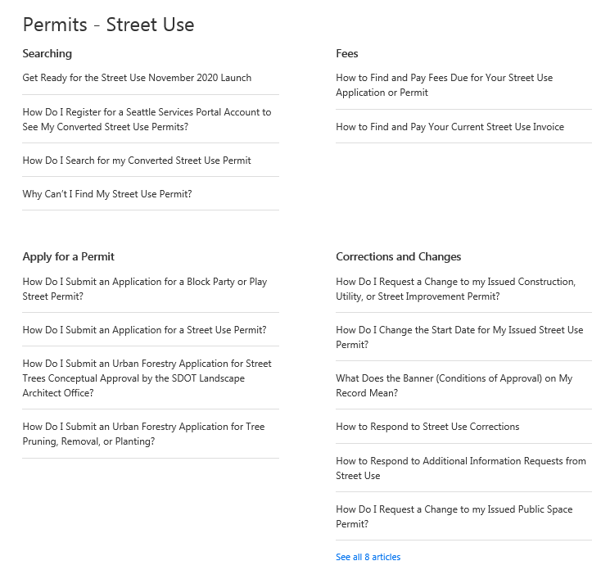
How to Find Help After Launch
Under Permits – Street Use, the following topics have Help articles
  Searching
  How to pay fees
  How to apply for a permit
  How to respond to a Corrections cycle
  How to request a change to a permit (aka amendment)
  Record information
  Inspections
Notes:
When a user needs help, they can access the Help Center articles by clicking on Help.
The banner is available throughout the portal, and Help can be accessed at any time simply by clicking on the Help button.

Slide 56
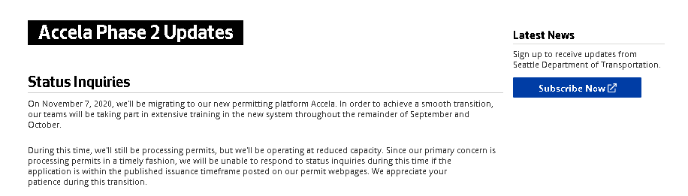
How to Find Help After Launch
How to find help on our website
Go to our Accela Phase 2 Updates website (http://www.seattle.gov/transportation/permits-and-services/permits/updates) to find information on the following:
  Previously recorded external training workshops and materials
  Launch support information (e.g. Accela phone line and email)
  Changes to help support (e.g. IT support, new Portal help articles etc.)
Notes:
When a user needs help, they can access the Help Center articles by clicking on Help.
The banner is available throughout the portal, and Help can be accessed at any time simply by clicking on the Help button.

Slide 57
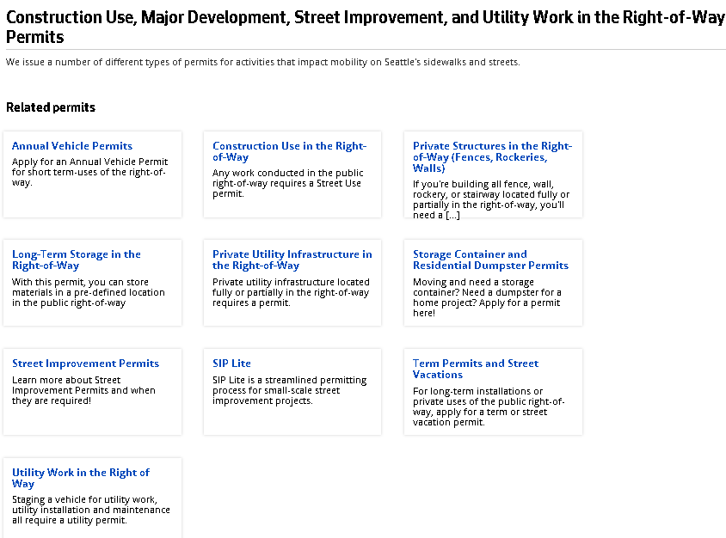
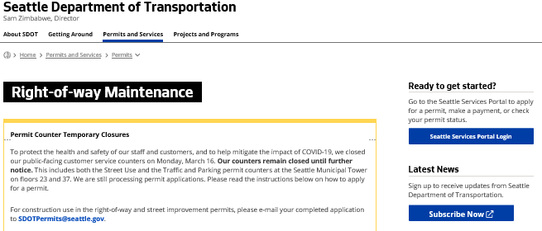
How to Find Help
After Launch
How to find help on our website
Go to our updated permit type pages (http://www.seattle.gov/transportation/permits-and-services/permits) to find information on the following:
    Permit thresholds
    Required documents
    What information needs to be on a document
    Plan templates
    Client Assistant Memos
Access to the Portal can be found on the right panel of every webpage
Notes:
When a user needs help, they can access the Help Center articles by clicking on Help.
The banner is available throughout the portal, and Help can be accessed at any time simply by clicking on the Help button.

Slide 58
How to set up a new user account and link to a converted contact
  You will only be able to view your converted permit(s) if your user account links to a converted contact
  This can be difficult if you are not sure what contact information is on your permit or if you had multiple contacts created in Hansen

Slide 59
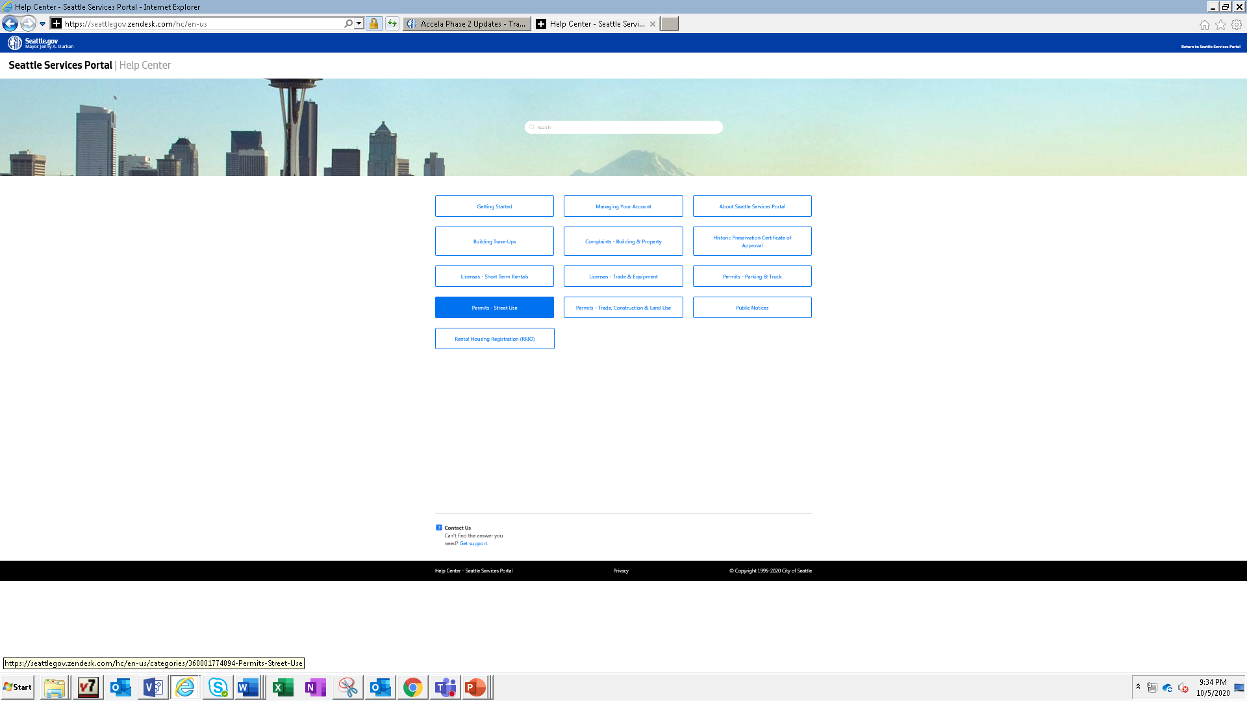

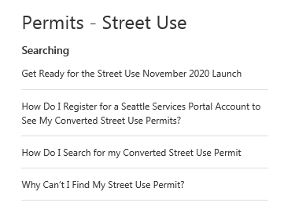
How to set up a new user account and link to a converted contact
  To create a new user account to link to a converted contact to see your converted permits:
  Go to the Seattle Services Portal
  Click on the Help link
  Follow the steps in the How Do I Register for a Seattle Services Portal Account to See My Converted Street Use Permits Help article
3

Slide 60


How to get help if you can’t find your converted permits
Please note: The below phone line and email will not be available until November 9th, 2020
If you are still unable to find your converted permit, please contact us using our dedicated Accela phone line or email address
You can expect to receive a response within 1-2 business days
Accela Support Phone Line
206-727-8640
Accela Support Email
dot_su_ssportal_questions@seattle.gov

Slide 61
Upcoming Q&A Sessions
Date | Time
Friday, Nov 13th | 10-11am
Tuesday, Nov 17th | 11am-12pm
Friday, Nov 20th | 1-2pm
Wednesday, Dec 2nd | 10-11am
Tuesday, Dec 8th | 11am-12pm
Opportunity to ask Accela and/or business process questions
Each session will be held virtually using WebEx Events
All previously recorded external training workshops can be found on our Accela 2 Updates website

Slide 62

Questions?
Melody.Berry@seattle.gov
www.seattle.gov/transportation

